Slide 1
Divide and Conquer Approach Dr. Tathagata Ray Assistant Professor, BITS Pilani, Hyderabad Campus rayt@hyderabad.bits-pilani.ac.in

Slide 2
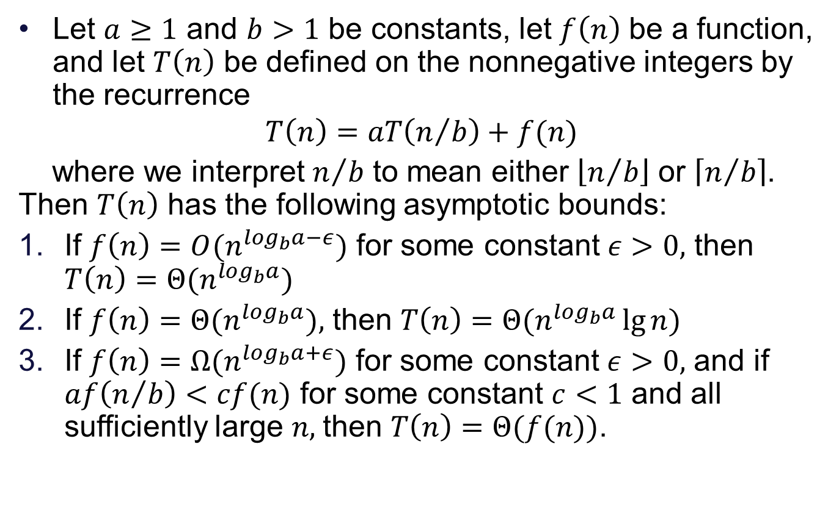
The Master Theorem
Let $a≥1$ and $b>1$ be constants, let $f\left(n\right)$ be a function, and let $T\left(n\right)$ be defined on the nonnegative integers by the recurrence
$$T\left(n\right)=aT\left(n/b\right)+f(n)$$
where we interpret $n/b$ to mean either $\left\lfloor n/b\right\rfloor$ or $\left\lceil n/b\right\rceil$. Then $T\left(n\right)$ has the following asymptotic bounds:
If $f\left(n\right)=O(n^{\log_{b}a−ε})$ for some constant $ε>0,$ then $T\left(n\right)=Θ(n^{\log_{b}a})$
If $f\left(n\right)=Θ(n^{\log_{b}a}),$ then $T\left(n\right)=Θ(n^{\log_{b}a}\lg{n})$
If $f\left(n\right)=Ω(n^{\log_{b}a+ε})$ for some constant $ε>0,$ and if $af\left(n/b\right)<cf(n)$ for some constant $c<1$ and all sufficiently large $n,$then $T\left(n\right)=Θ(f(n))$.

Slide 3
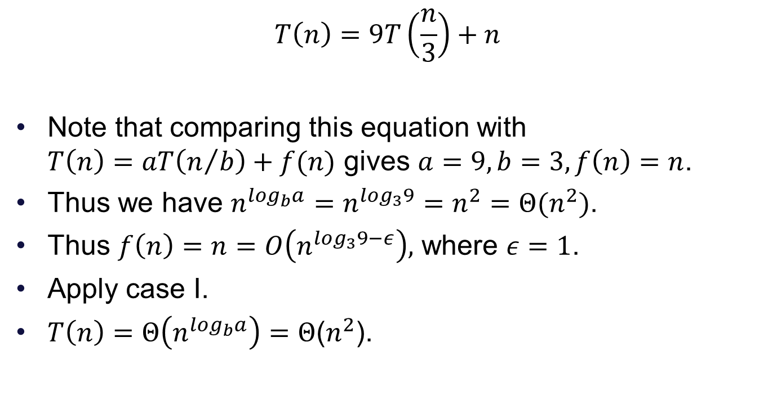
Example-I
$$T\left(n\right)=9T\left(\frac{n}{3}\right)+n$$
Note that comparing this equation with $T\left(n\right)=aT\left(n/b\right)+f(n)$ gives $a=9, b=3, f\left(n\right)=n$.
Thus we have $n^{\log_{b}a}=n^{\log_{3}9}=n^{2}=Θ(n^{2})$.
Thus $f\left(n\right)=n=O\left(n^{\log_{3}9−ε}\right),$ where $ε=1$.
Apply case I.
$T\left(n\right)=Θ\left(n^{\log_{b}a}\right)=Θ$($n^{2}$).

Slide 4
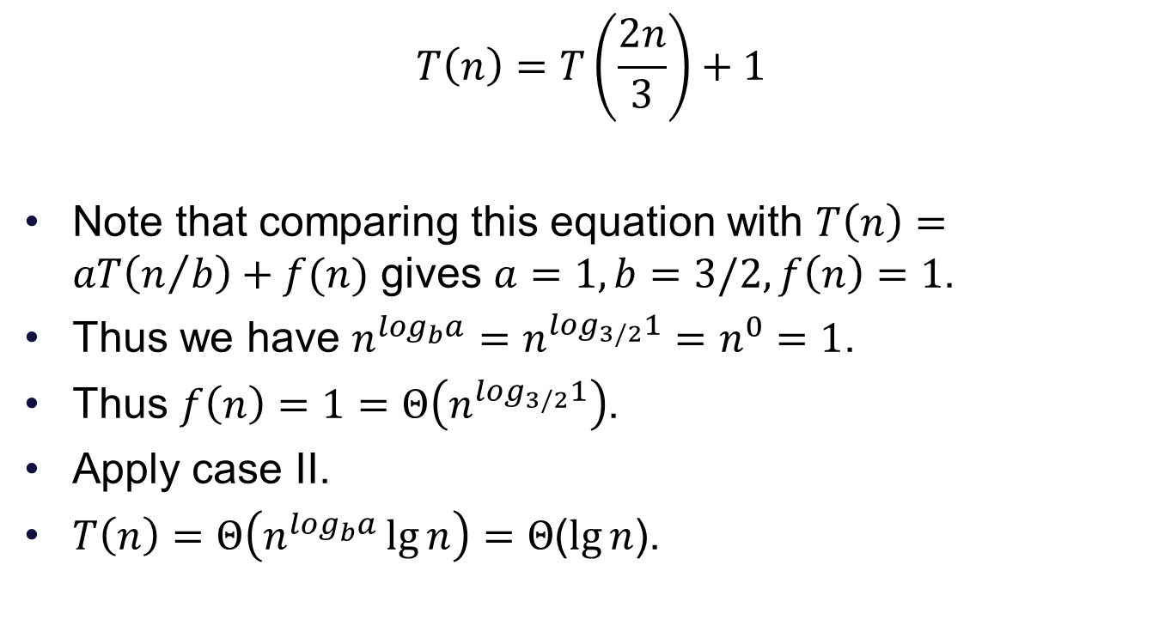
Example-II
$$T\left(n\right)=T\left(\frac{2n}{3}\right)+1$$
Note that comparing this equation with $T\left(n\right)=aT\left(n/b\right)+f(n)$ gives $a=1, b=3/2, f\left(n\right)=1$.
Thus we have $n^{\log_{b}a}=n^{\log_{3/2}1}=n^{0}=1$.
Thus $f\left(n\right)=1=Θ\left(n^{\log_{3/2}1}\right)$.
Apply case II.
$T\left(n\right)=Θ\left(n^{\log_{b}a}\lg{n}\right)=Θ$($\lg{n}$).

Slide 5
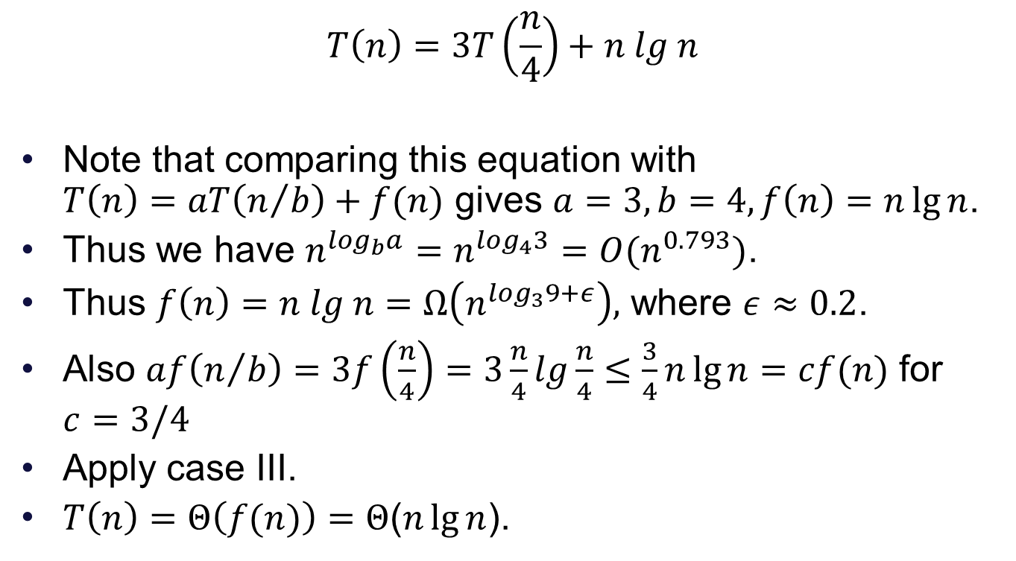
Example-III
$$T\left(n\right)=3T\left(\frac{n}{4}\right)+n lg n$$
Note that comparing this equation with $T\left(n\right)=aT\left(n/b\right)+f(n)$ gives $a=3, b=4, f\left(n\right)=n\lg{n}$.
Thus we have $n^{\log_{b}a}=n^{\log_{4}3}=O(n^{0.793})$.
Thus $f\left(n\right)=n lg n=Ω\left(n^{\log_{3}9+ε}\right),$ where $ε≈0.2$.
Also $af\left(n/b\right)=3f\left(\frac{n}{4}\right)=3\frac{n}{4}lg\frac{n}{4}≤\frac{3}{4}n\lg{n}=cf(n)$ for $c=3/4$
Apply case III.
$T\left(n\right)=Θ\left(f(n)\right)=Θ$($n\lg{n}$).

Slide 6
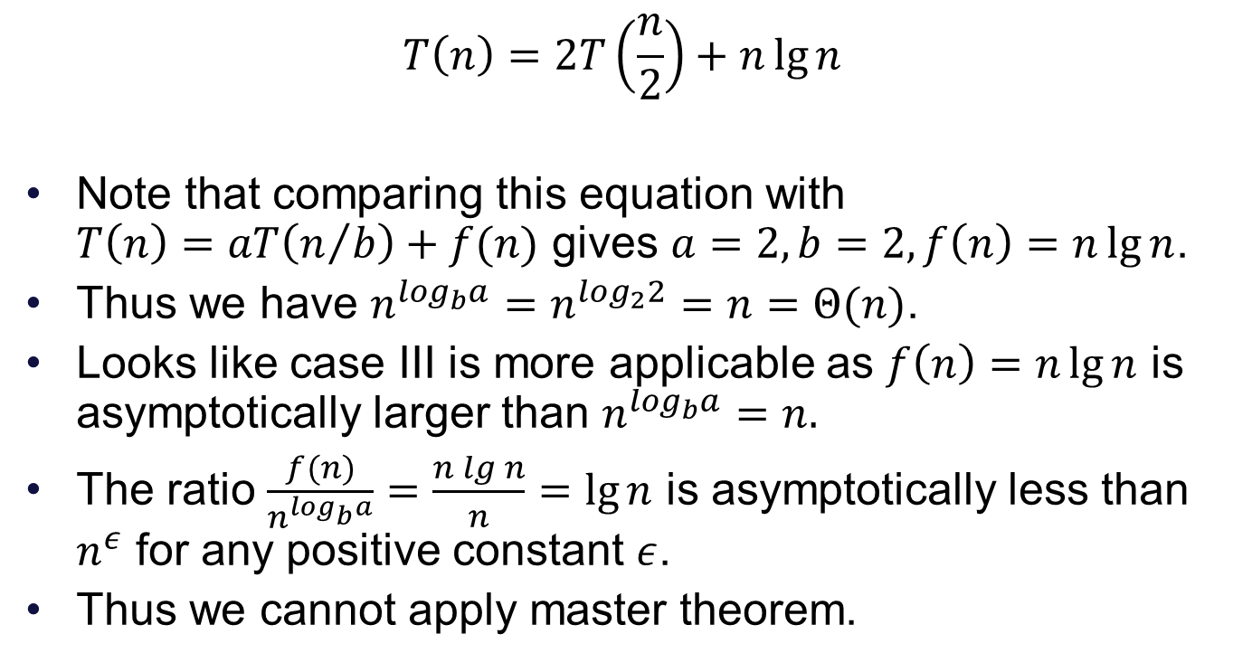
Example-IV
$$T\left(n\right)=2T\left(\frac{n}{2}\right)+n\lg{n}$$
Note that comparing this equation with $T\left(n\right)=aT\left(n/b\right)+f(n)$ gives $a=2, b=2, f\left(n\right)=n\lg{n}$.
Thus we have $n^{\log_{b}a}=n^{\log_{2}2}=n=Θ(n)$.
Looks like case III is more applicable as $f\left(n\right)=n\lg{n}$ is asymptotically larger than $n^{\log_{b}a}=n.$
The ratio $\frac{f(n)}{n^{\log_{b}a}}=\frac{n lg n}{n}=\lg{n}$ is asymptotically less than $n^{ε}$ for any positive constant $ε$.
Thus we cannot apply master theorem.

